Slide 1


WQD7005 (Data Mining) MILESTONE 4 : “Interpretation of data & Communication of Insights of data ”
Prepared by:
Sivanesan Pillai (WQD 170074)

Slide 2

Introduction
This is a presentation on student alcohol consumption from two group of high school students. This data are obtained from Kaggle (This link here) and this data are divided into two parts:
Math class Students
Portuguese class students
For this Milestone 4 exercise, I have used R language and the relevant libraries as the programming language.

Slide 3
Research Goal & Objective
To predict the variables that lead to alcohol consumption for these two group of students
Correlation between features
How alcohol consumption is correlated to academic performance.
How family influences students’ alcohol consumption
How your desire for higher education correlates with alcohol consumption
Does alcohol have an effect on success?

Slide 4

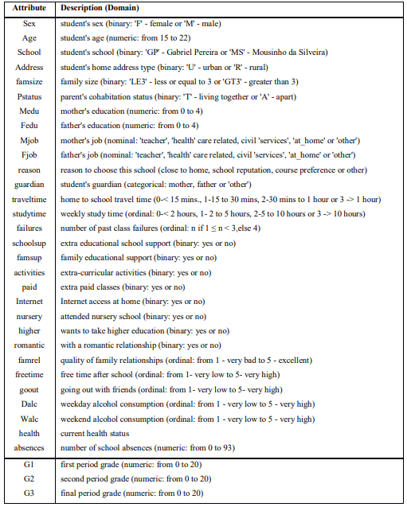



Data Variables
There are 33 columns.
There are several students that belong to both datasets .
These students can be identified by searching for identical attributes that characterize each student, as shown in the annexed R file.

Slide 5

Data Preprocessing
Real-world databases are highly susceptible to noisy, missing and inconsistent data due to their typically huge size.
Low-quality data will lead to low-quality results.
I have used several data pre-processing techniques:
Perform data cleaning to remove noise and correct inconsistencies in data and merge two different dataset by using data integration.
There are many possible reasons for inaccurate data (i.e., having incorrect attribute values).
Users may purposely submit incorrect data values for mandatory fields when they do not wish to submit personal information. This is known as disguised missing data.

Slide 6
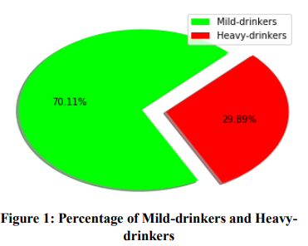
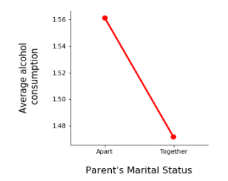

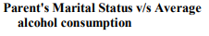
Analysis Results
After completing the data preprocessing, we perform some analysis and here are some results. Figure 1 tells us about the percentage of Mild-drinkers and Heavy-drinkers, i.e., those who ingest small quantity and those who ingest large quantity of alcohol. It is clear that the number of people who do not consume much alcohol is way larger. Nearly 70.11% of the students are mild drinkers whereas only 29.89% of the students are heavy drinkers.
Figure 2 represents that average consumption of alcohol is very high where parents are not together or are divorced compared to where parents’ marriage is a success and they are together. Hence, it is a key factor in determining the indulgence of a child in alcoholic activities.

Slide 7
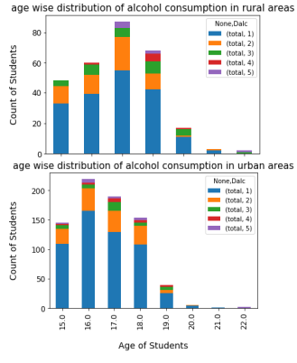
Analysis Results (continues)
These graphs show the age of students’ v/s count of students who are active drinkers in rural and urban areas. For example, it is clear from Figure that, most drinkers are of the age 16 and 17 in the rural and urban areas. Hence, it is the most crucial time to keep an eye on the behavior of students and to help them out of their crisis. It also shows that there is a drastic decline in the number of drinkers when they turn out to be 19. Thus, it can be safely concluded that as the children grow to be 19, they become much more mature.
Figure 3 : Age wise distribution of alcohol consumption in rural and urban areas

Slide 8
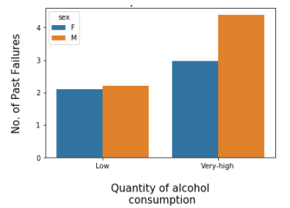
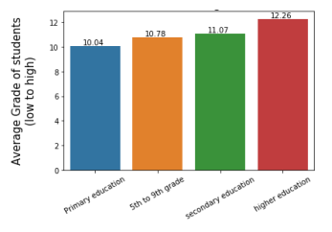
Analysis Results (continues)
In figure 4 we can clearly see that, those who consume high quantity of alcohol have faced more failures in their life than those who consume less quantity. Among the alcoholics too, it seems that males have suffered failures more than females. So, it can be safely concluded that alcohol consumption leads to more failures in life. And therefore, alcohol should be avoided in order to succeed in life.
Figure 4 : Amount of alcohol consumption v/s Failures
From the figure 5, it is clear that this factor “Maximum Education of Parents” is a crucial factor in determining the average grades obtained by the students. It can be said that those families where the 50 parents are highly educated, average grades of students are higher compared to those families where the parents are not very educated.
Figure 5: Parent's Education v/s Average Grade of students

Slide 9
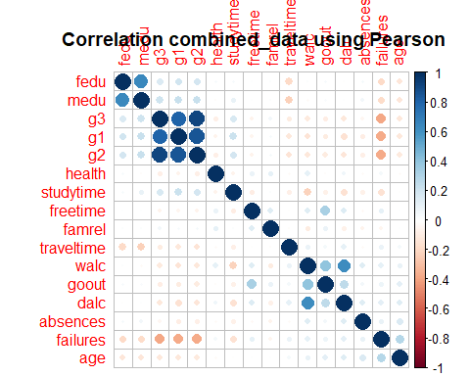
Correlation
The grades are highly correlated to each other. I think it is safe to say that we can take the average to represent all of the variable.
Failures also is correlated to the grades. If we want to try to predict the grades, this failure also can also be as a target since it is highly correlated to the grades. Hence we can remove it for model building.
Daily alcohol consumption and weekend alcohol consumption also is highly correlated. Hence, we will take the total of both of these column to represent the total weekly alcohol consumption.

Slide 10
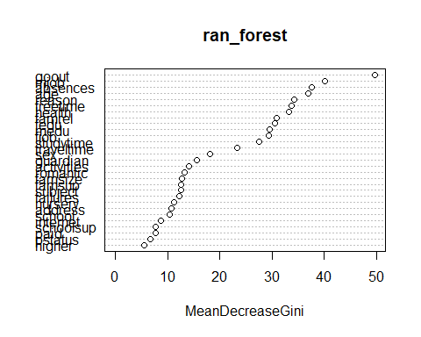
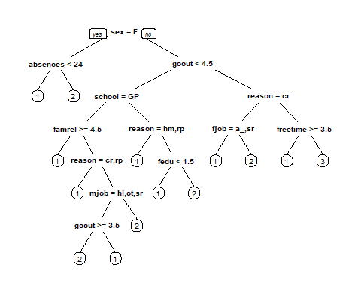
Machine Learning
I have modelled the weekend alcohol consumption (variable walc) and daily alcohol consumption (variable dalc) from the data using Random Forest as well as with Decision tree.

Slide 11
Conclusion
Through this study I have learned that significant factors that contribute in the indulgence of teenagers in alcoholic activities and affect their academic performance in high schools.
Age, sex and home address was identified as the most significant factors in consuming alcohol by students. At the age of 15-21 they want to prove to their friends and to the society that they are no longer kids.
The home environment is also a primary socialization agent, which affects students’ life outside the school, the interest in school as well as the aspirations for the future. Home environment includes parental socio-economic status, parental education background, parental marital status and the quality of family relations, etc. Quality of family relations is one of a key factor.
Students from broken homes suffer psychological effects while in school and this affects their academic performance.
Therefore, family support is a crucial factor in determining the grades and hence, the future of children and should be kept in mind. It is also identified that those who consume high quantity of alcohol have faced more failures in their life than those who consume less quantity.
So, it can be safely concluded that alcohol consumption leads to more failures in life. And therefore, alcohol should be avoided in order to succeed in life and it is high time to handle all these which can be done with the effort of school, family and students themselves

Slide 12
THANK YOU ! Prof. Dr. Teh Ying Wah.

